Slide 1

TALLA PADMAVATHI
COLLEGE OF ENGINEERING
A Major Project Presentation
on
FACIAL AND HAND GESTURE BASED MEDIA PLAYER
BATCH - I
Under The Guidance Of:
Team Members:
16UC1A0539-P.Thirupathi
Dr . A .Kiranmayee
16UC1A0514-B.Vani
(Principal)
16UC1A0520-D.Vaishnavi
16UC1A0547-S.Sony

Slide 2
ABSTRACT
Advanced technologies are the key factor for device control in today’s world. Currently, remotes - both handheld and cell phone based are used for the purpose. In this project, we develop an advanced media player HCI which uses facial and hand gestures to play and pause video. A simple web camera monitors user gestures such as whether the user looks at the tv screen or faces elsewhere. In case the system does not detect user's face pattern in full, then it immediately stops the video.
Other features of media player such as volume up and volume down, backward and forward video are also implemented in our project using hand gestures.
<number>

Slide 3
INTRODUCTION
While watching a video when someone interrupts us and we have to look somewhere else or temporarily move away from the system for some time we need to manually set back the video to them point of leaving. This leads to the problem of loss of power and/or internet resources since the system/tv is not paused . This project proposes and implements solution to this problem - A media player that gets paused automatically when user’s is not looking at it. The media player resumes again as soon as the user’s looks at it again. This is done by image data input from the web camera that picks up images every 3 seconds. The media player plays uninterrupted as long as the camera detects the user's face.
The media player pauses as soon as user’s face is not completely detected. This system also provides the feature of controlling other functions of media players such as play, pause, volume up, volume down, next using hand gestures helps to change to a new video . At present, the implementation detects a single user.
<number>

Slide 4
LITERATURE SURVEY
Information Retrieval:
Many researchers have proposed numerous methods for hand gesture recognition systems. Generally, such systems are divided into two basis approaches namely glove − based and vision − based approaches. In glove based analysis, detection of the hand is eliminated by the sensors on the hand and 3D model of the hand is easily subjected to the virtual world and analysis comes next. Such systems are optimal for body motion capture purposes and widely used in industry. On the other hand vision-based analysis are more natural and useful for real time applications.
<number>

Slide 5
LITERATURE SURVEY
Detection Methods:
In recent years, with the introduction of a new approach , which has a high detection rate , new studies are mostly concentrated on Boosting and HMM. The most tempting side of using those methods is that they usually work with gray scale images instead of colored images and thus it eliminates the drawbacks of such color based noise issues. This innovative approach is using a well-known technique namely Adaboost classifier . Adaboost classifier is an effective tool to select appropriate features for face detection. This feature extraction technique does not need skin color information and have less computation time with the use of integral image concept. But the drawback of this method is that it re-quires a training process . This process often needs huge-sized sample images to have a high detection rate.
<number>

Slide 6
LITERATURE SURVEY
Recognition Methods:
Many studies in literature use different skin locus thresholds for different color spaces to locate faces or hands in images starts with an RGB image and by apply a dimension reduction algorithm to propose its own skin locus in two dimension to compare its performance with HSV skin locus compare HSV/HSI,RGB,TSL and YcbCr color space skin locus performances starts the segmentation of skin color in YUV color space to have a quick result and then tune the current skin color with a quasi-automatic method which needs some user input. In chrominance along with luminance information in YcbCr color space was used to segment the skin color for current conditions and histogram clustering is used for fine skin segmentation.
<number>

Slide 7
EXISTING SYSTEM
Mostly existing systems use eye recognition. Due to which results aren’t accurate. Face recognition and hand gestures are not implemented properly together and not even individually.
Disadvantages :
There is a problem with the existing system. First, it involves a high computational cost, since we would have to repeat a large number of gestures similarity computations for every gesture.
<number>

Slide 8
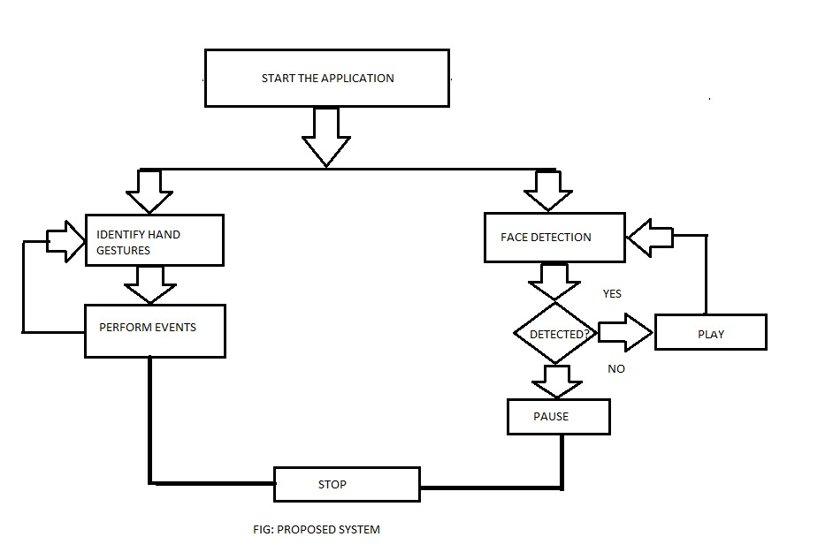
<number>
PROPOSED SYSTEM
In this project we are using face recognition and hand gestures for controlling media player. Face recognition is used for pausing and playing. Various hand gestures are used for controlling other functions of media player.

Slide 9
Proposed system
Advantages :
Facial and hand gesture based media player following advantages:
Users cannot miss any part of the video.
The video stops as user changes their view from the video thereby no need of users to keep on dragging back to the point from where they missed.
You can also forward and backward the video if required.
It saves time and electricity.
It gives accurate result
<number>

Slide 10
REQUIREMENTS
Hardware Requirements:
Processor: Pentium IV or higher
RAM: 1 GB
Space on hard Disk: 1 GB
Device: 512 MB Web Cam
Software Requirements:
Application Development –Python , Open CV , Numpy
Operating System: Ubuntu/Unix
Environment Specifications:
A clear white background . There should be no other objects (specially skin colored objects) in front of the webcam other than Palm and face.
<number>

Slide 11
MODULES
Here as soon as we start the media player it will be opened with face detection mode i.e. it will start detecting human face and if a face is detected the video will keep on playing if there is no face the video will be paused. This media player has an option to run media player with either face detection mode or hand gesture mode and it can switch between them in run time. In hand gesture mode we control the mouse cursor to operate the media player.This project consists of three modules . They are
1.Face Detection
2.Hand Gesture
3.Media Player
<number>

Slide 12
MODULES
Face Detection :
Open CV’s face detector uses a method that Paul Viola and Michael Jones had published in 2001. Usually this approach detects the objects in images which combines some key concepts:
Simple rectangular features which are called as Haar features.
An integral Image for quick feature detection.
A cascaded classifier to combine many features.
In this section the camera starts detecting a human face and till the time we are looking at the media player screen the video will be played and if we look somewhere else the video will be automatically paused. It will start playing the video as soon as it detects a face again.
<number>

Slide 13
MODULES
Hand Gesture :
In this section the camera looks for the color bands. The user will wear 2 bands on his fingers they are green and blue color bands. Here the blue color band controls mouse cursor and green color band performs left click operation. Thus we can control the media player.
<number>

Slide 14
MODULES
Media Player :
The media player is the important concept which will be used to play video and it will be controlled by functionalities like hand gesture and face detection. A gesture input images are taken from camera and images will be processing . It compares the both input and data base images and It perform forward, backward, volume up & volume down . A simple web camera monitors user gestures such as whether the user looks at the tv screen or faces elsewhere. In case the system does not detect user's face pattern in full, then it immediately stops the video.
<number>

Slide 15
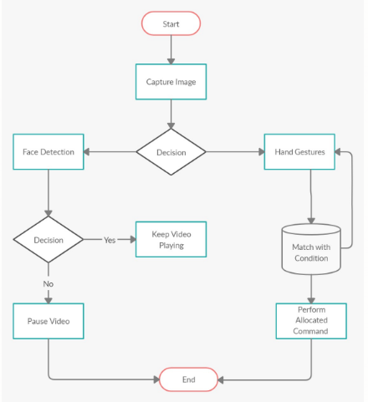
Design phase
Data flow Diagram
<number>

Slide 16
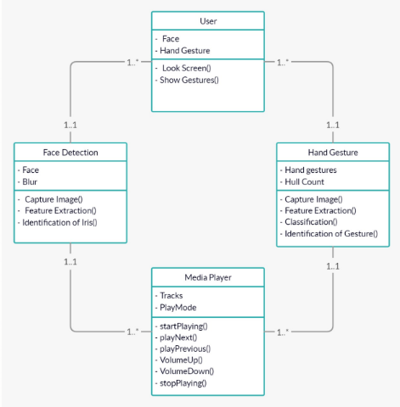
DESIGN PHASE
Class Diagram
<number>

Slide 17
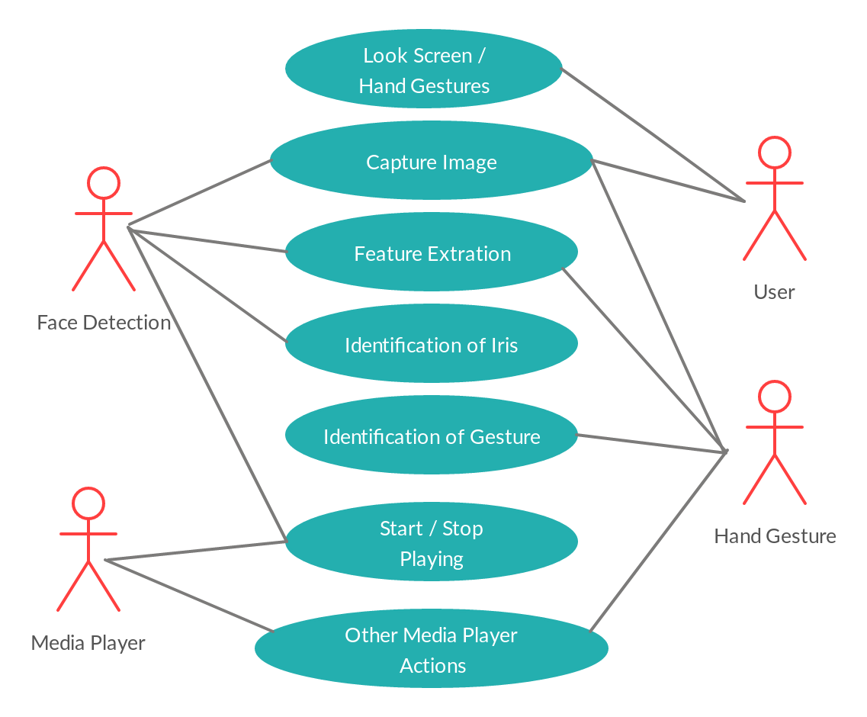
DESIGN PHASE
Use case Diagram
10
Notes:
<number>

Slide 18
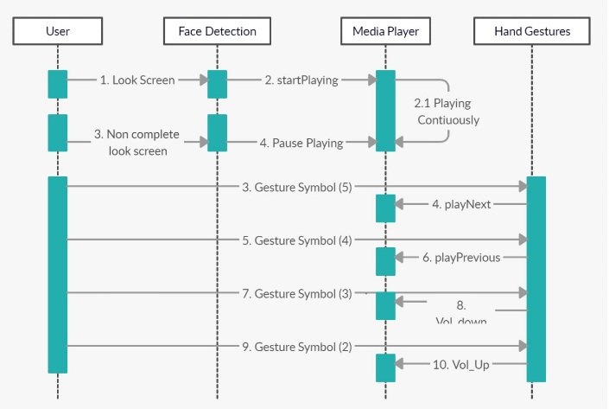
Design phase
Sequence Diagram
<number>

Slide 19
Future Scope
This enhanced media player can help in minimizing human efforts. In future, this technique can be used to control system using HCI like pdf reader , power point etc. We can add multiple users for face / hand gesture recognition for controlling varied features of the media player.
<number>

Slide 20

<number>

